Slide 1
Gravitational Waves
Sam Grobelny, Sacha Wible, Wentao Zhong

Slide 2
Motivations
Methods + Assumptions
By studying black hole mergers via gravitational waves, we can figure out the distance from Earth. Comparing this to redshift of the light from these events allows us to better understand the universe's expansion.
By using gravitational wave data collected from LIGO we should be able to calculate the masses of the two black holes that merged in order to cause the wave.

Slide 3
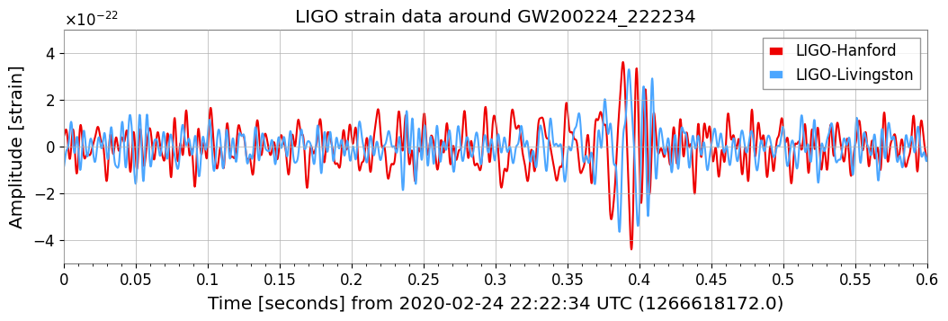
Notes:
Strain is the change in distance caused by the gravitational wave

Slide 4
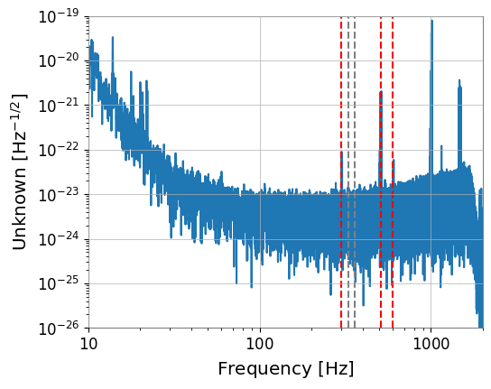
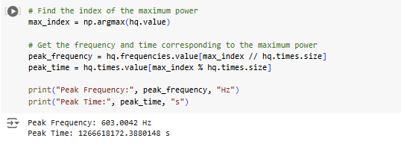

Fast Fourier transform - GW200224_222234
Notes:
By transforming the data into a frequency domain, its easier to tell which frequencies dominate the sample and how they vary over time, as well as improving the Signal to Noise ratio

Slide 5



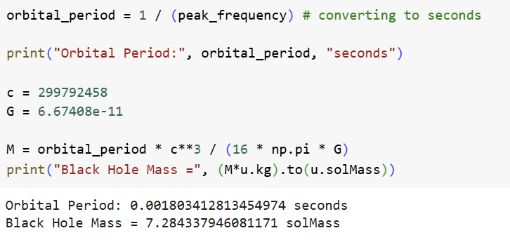
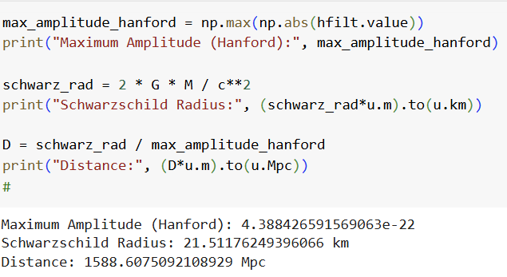
Black Hole Mass
Black Hole Distance
We can also use the peak frequency to derive the orbital period, which can be used with the orbital velocity and Schwarzschild radius formula to get
We can also use the mass of the black holes and the Schwarzschild radius formula again to get

Slide 6

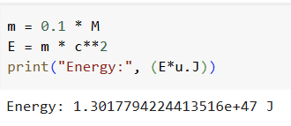
Energy Lost
We can use Einstein’s formula to estimate the amount of energy released in the black hole merger.

Slide 7
Conclusion
AI Acknowledgement
Black holes are big. Gravitational waves tell us a lot about the universe, such as how far things can be. Measuring the distance of objects in the universe, combined with redshift data, could also help us get a handle on the age of the universe.
I used AI to generate the code for the peak frequency, and max strain.

